Slide 1

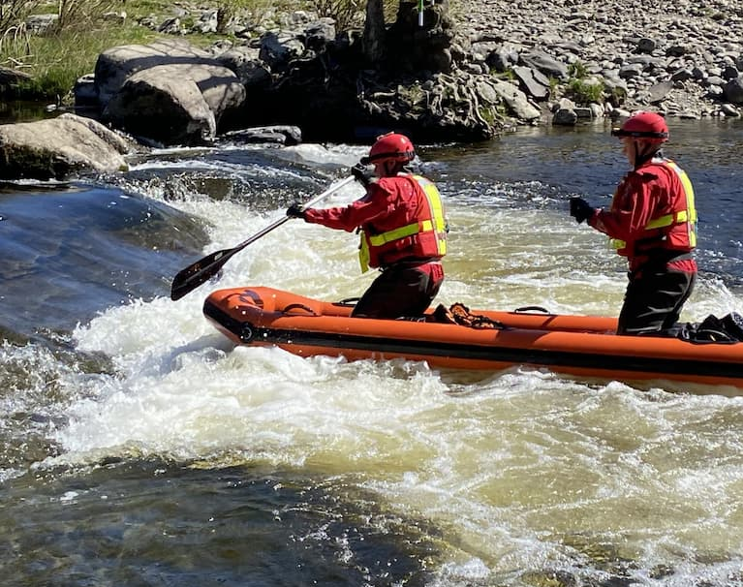
Keeping Young People Safe Around Water

Slide 2
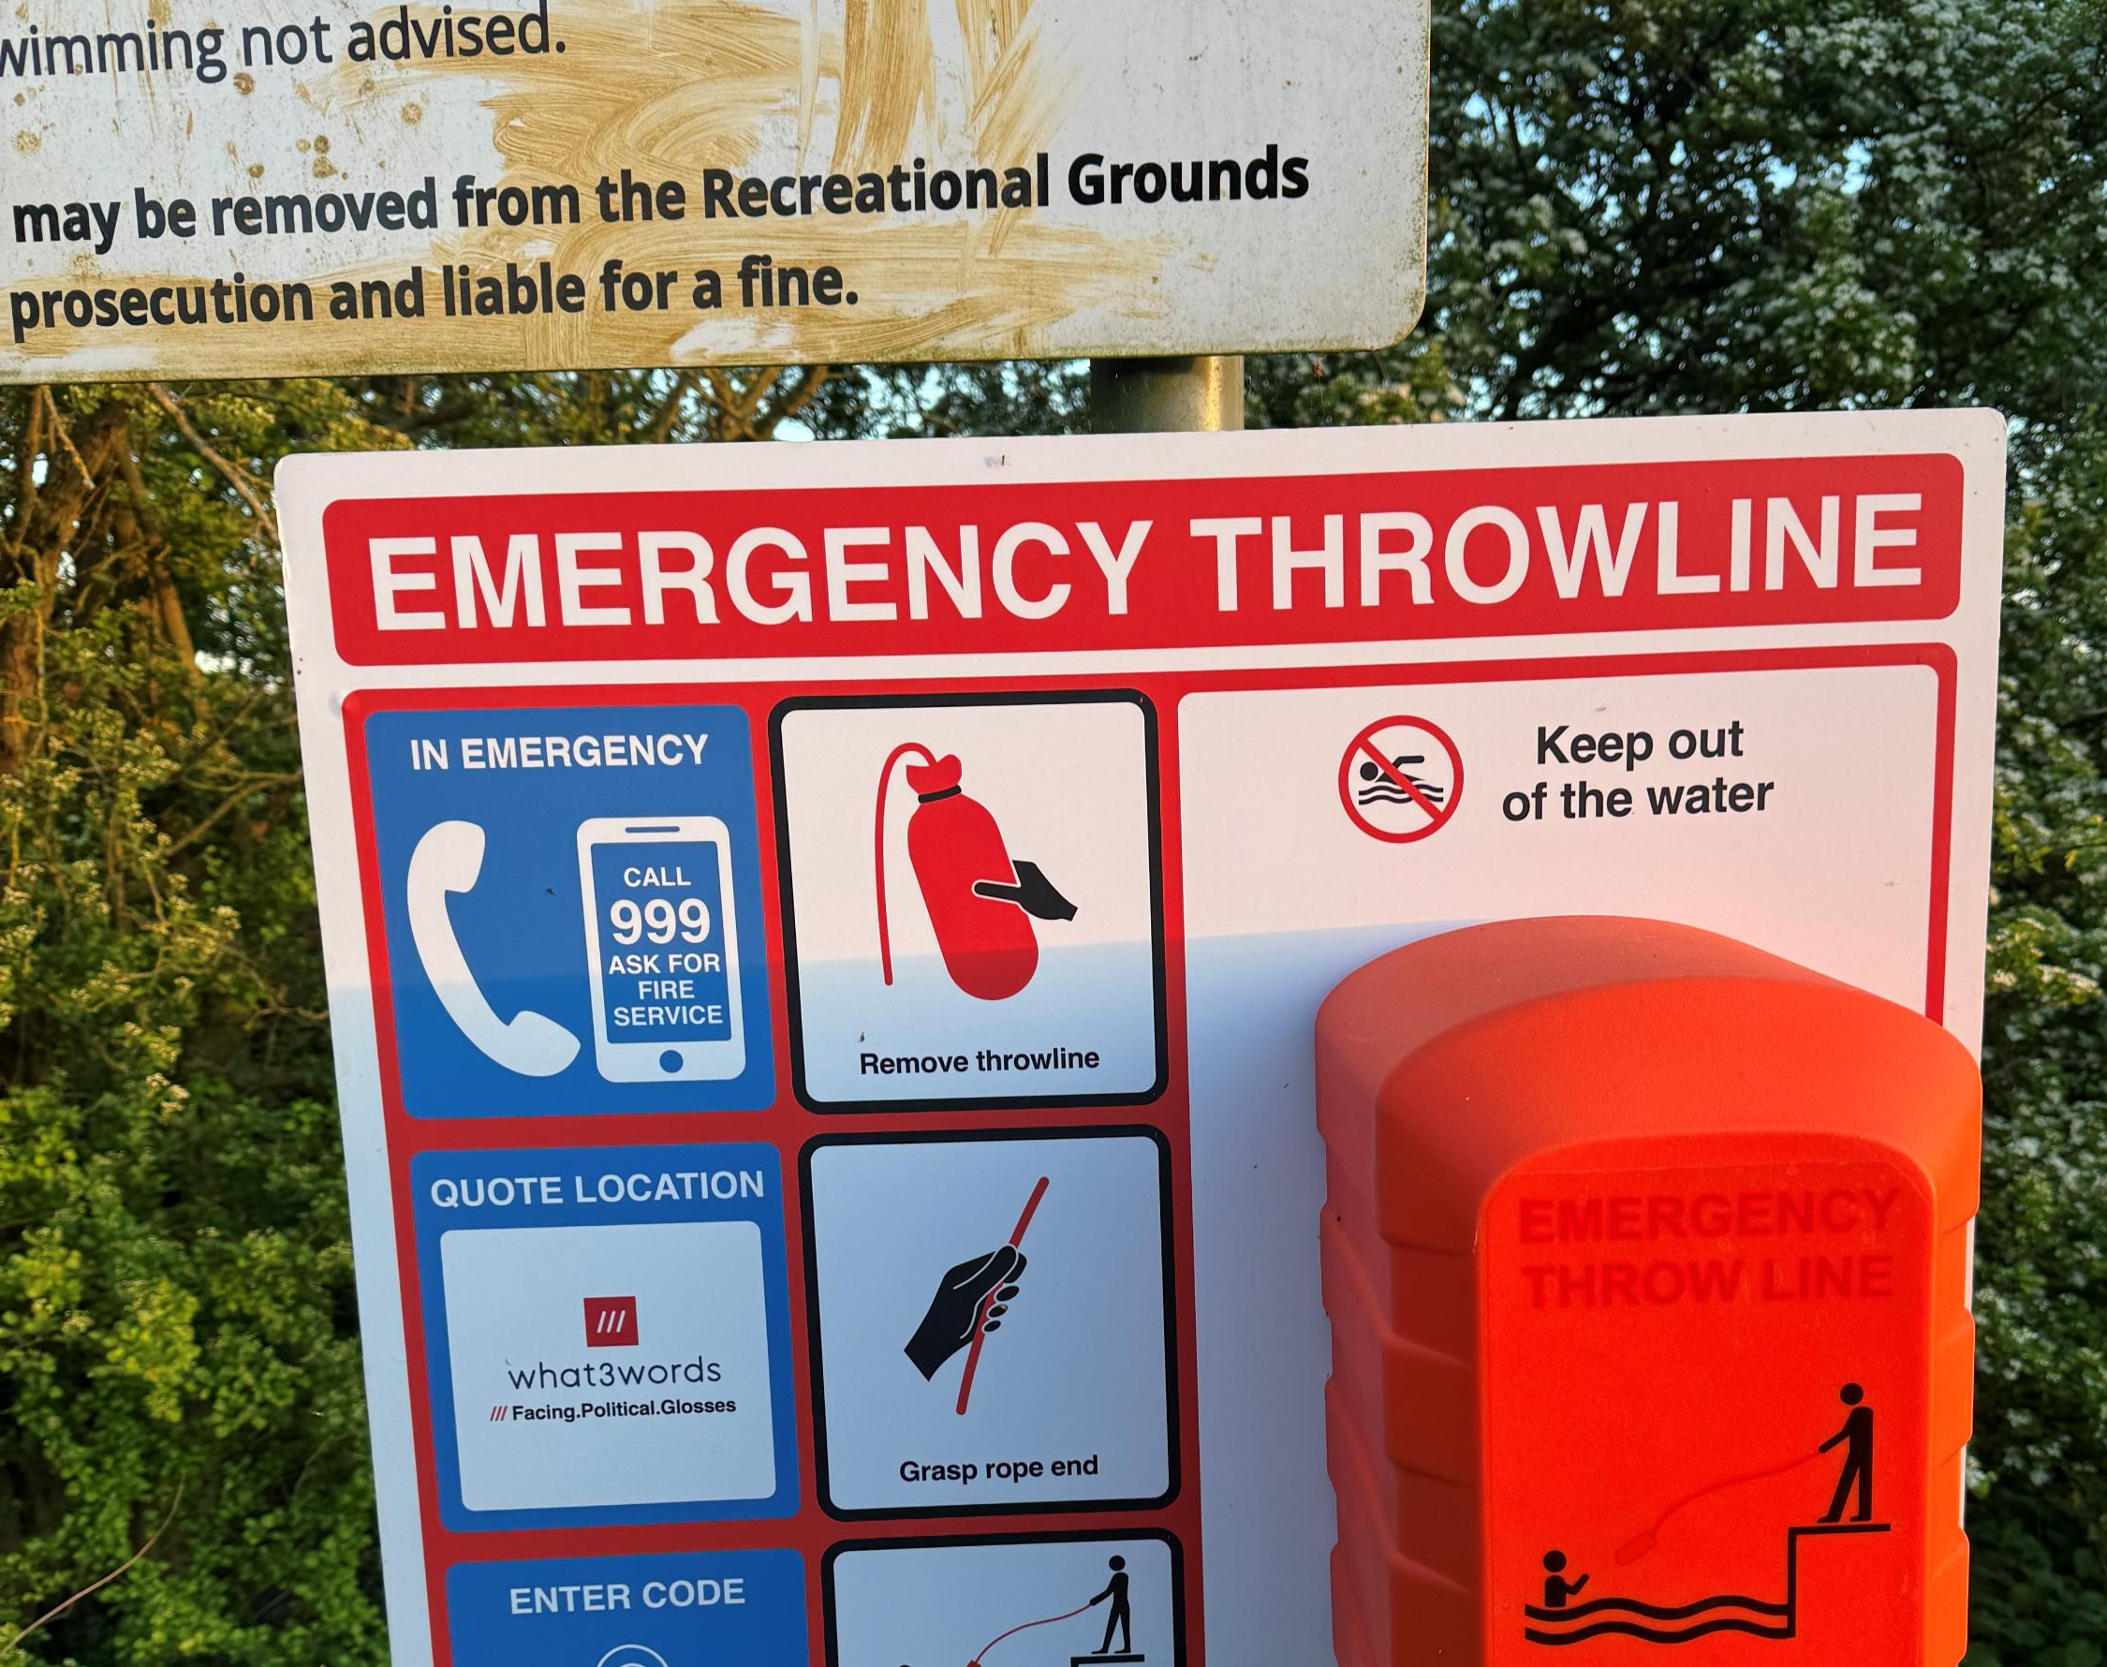
Why This Matters
Over 1,600 people have accidentally drowned in the UK in the last 5 years
63% of drownings happen in inland water, such as rivers and lakes
82% of people who drowned are male
Alcohol/drugs are only present in 22% of drownings
Most incidents are preventable

Slide 3
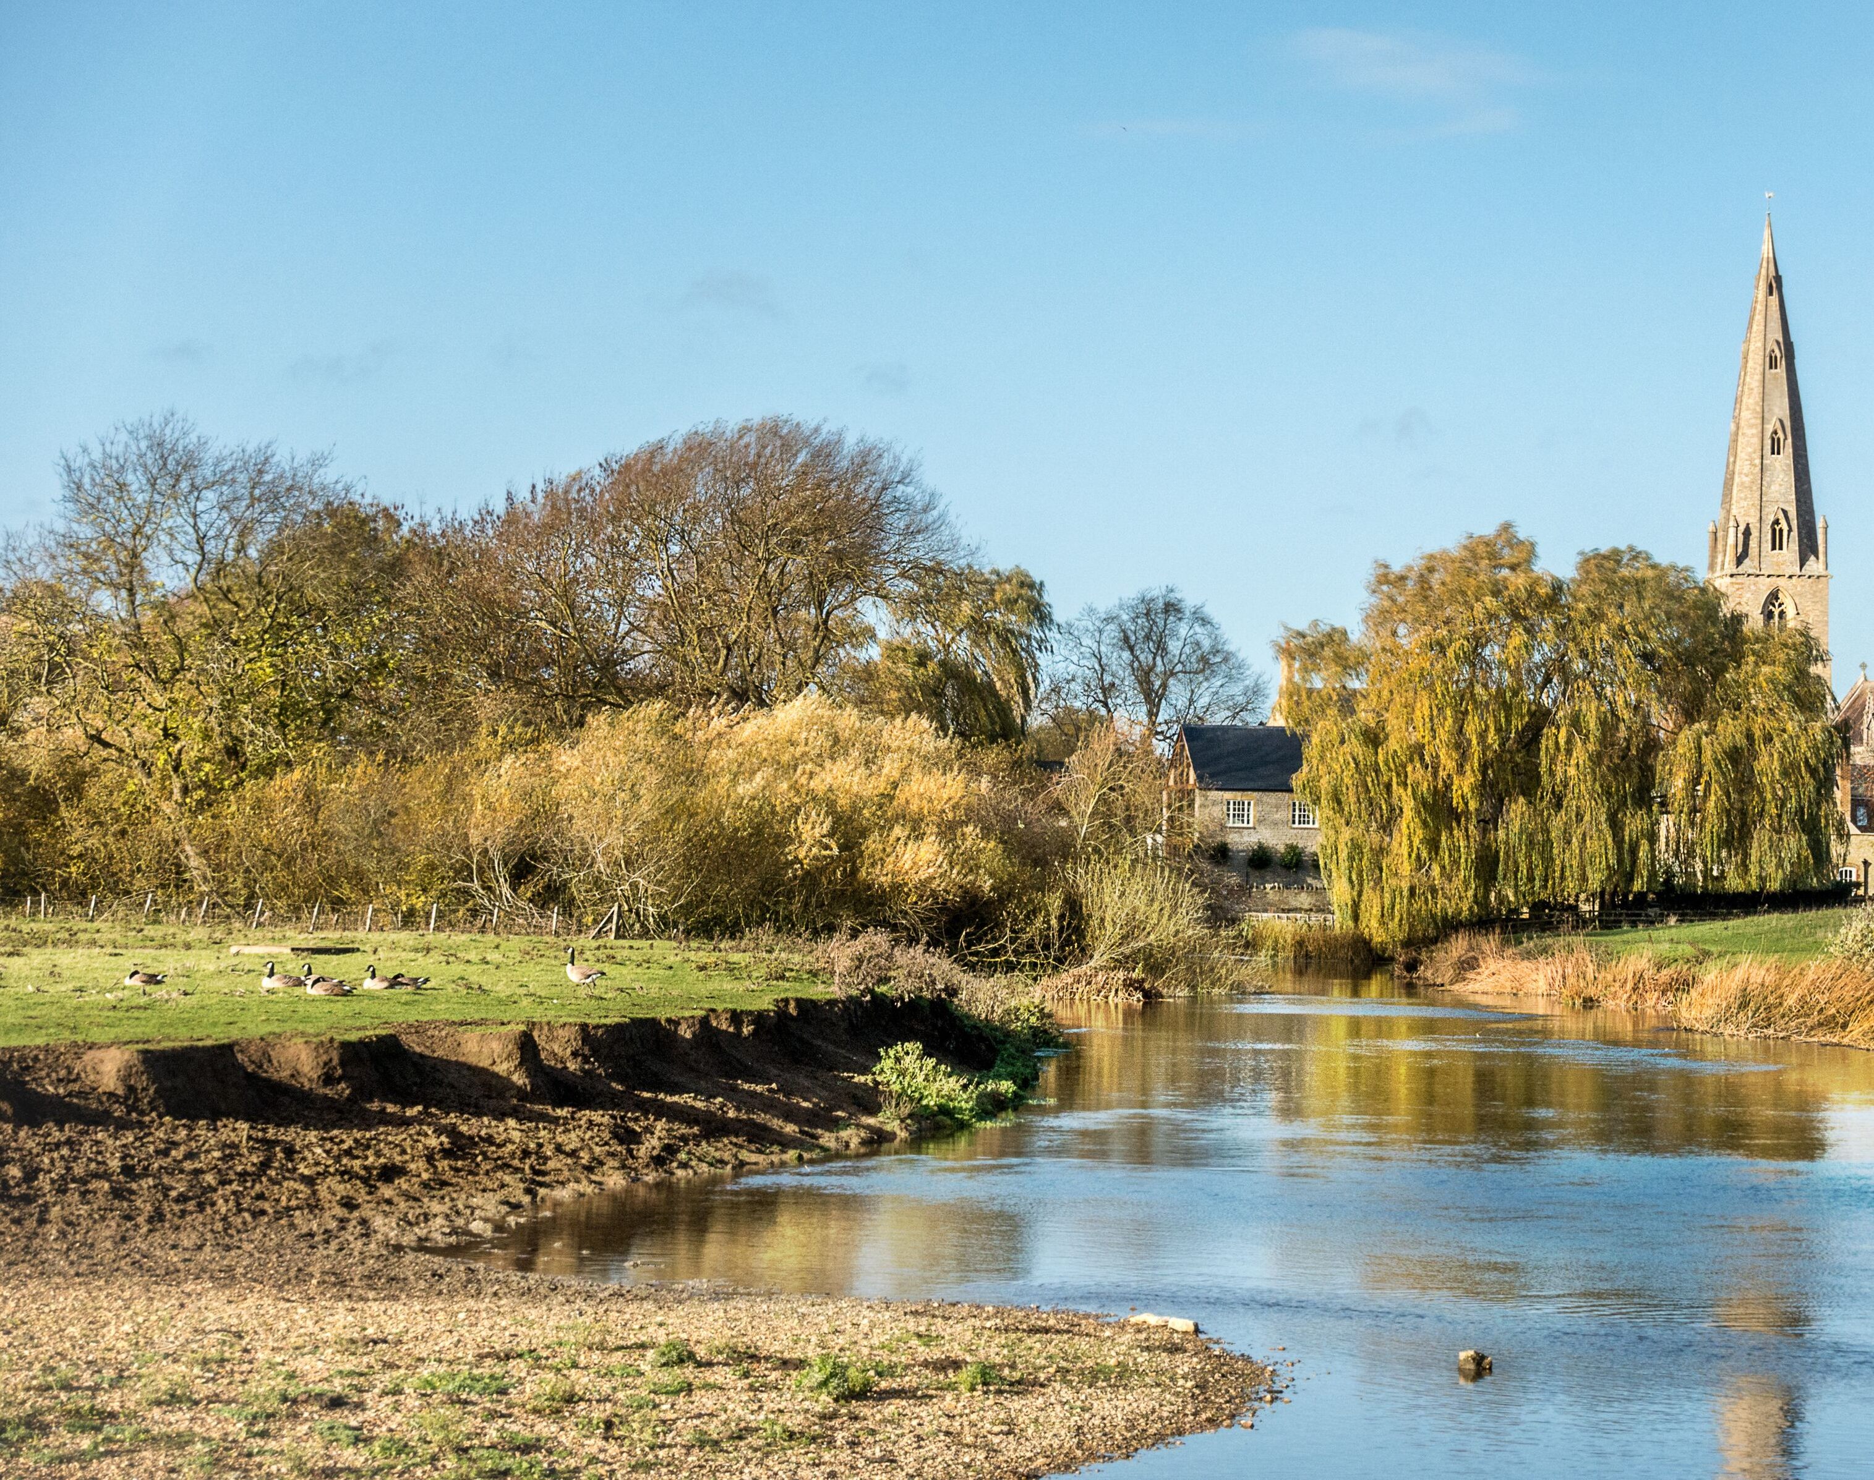
Where & Why Young People Are At Risk
Water Locations
Environmental Risks
Contributing Risk Behaviours
Safety Awareness Importance
Open water is very different to a swimming pool

Slide 4
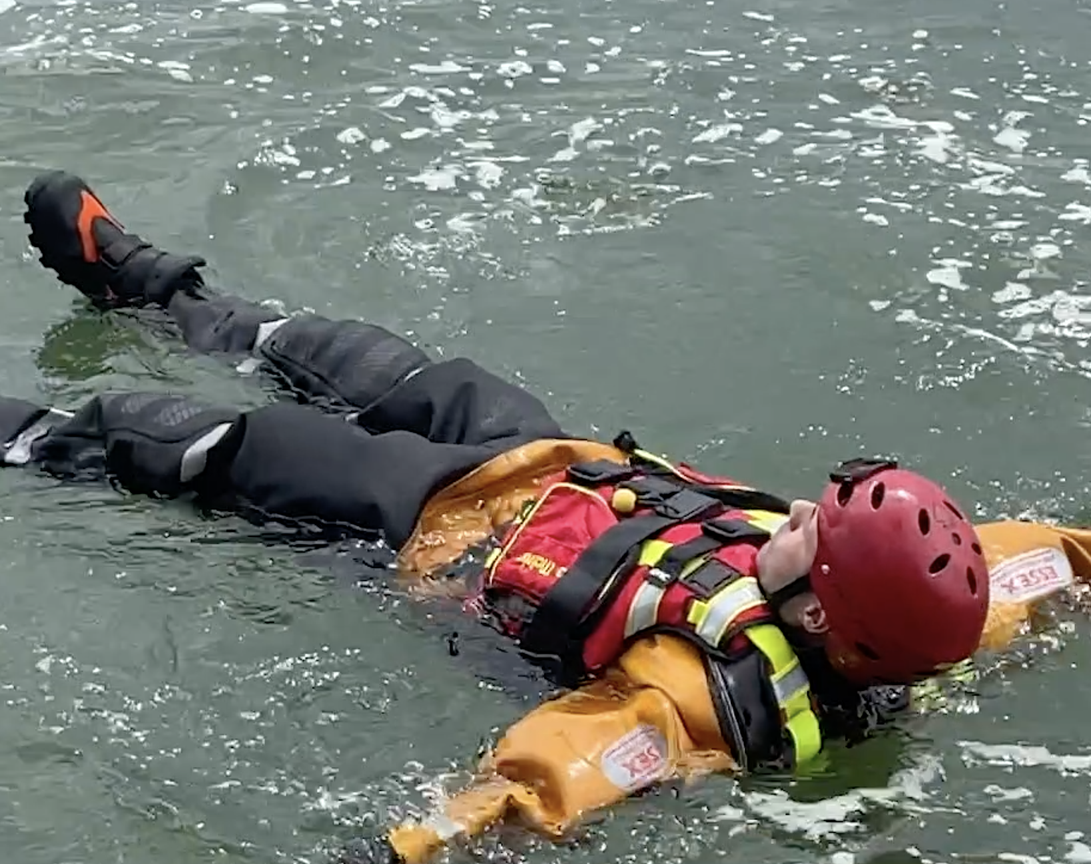
Cold Water Shock & Float to Live
Cold Water Shock
  Sudden gasp
  Loss of breathing control
  Panic
Float to Live
  Lean back
  Spread arms & legs
  Control Breathing

Slide 5
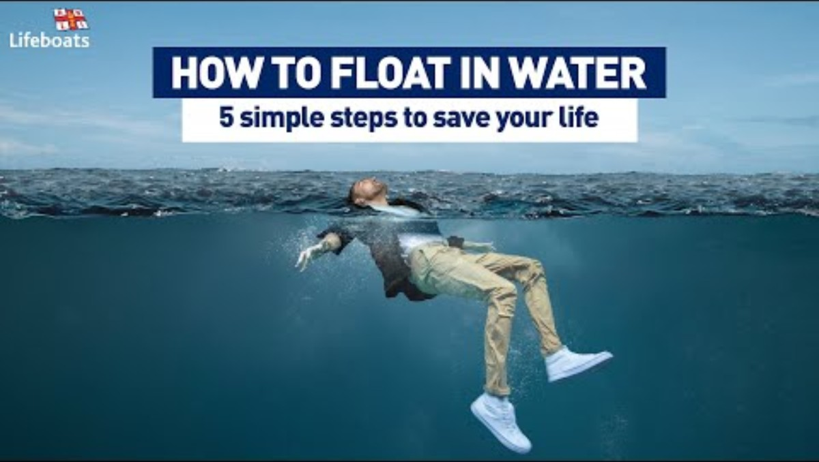

Slide 6
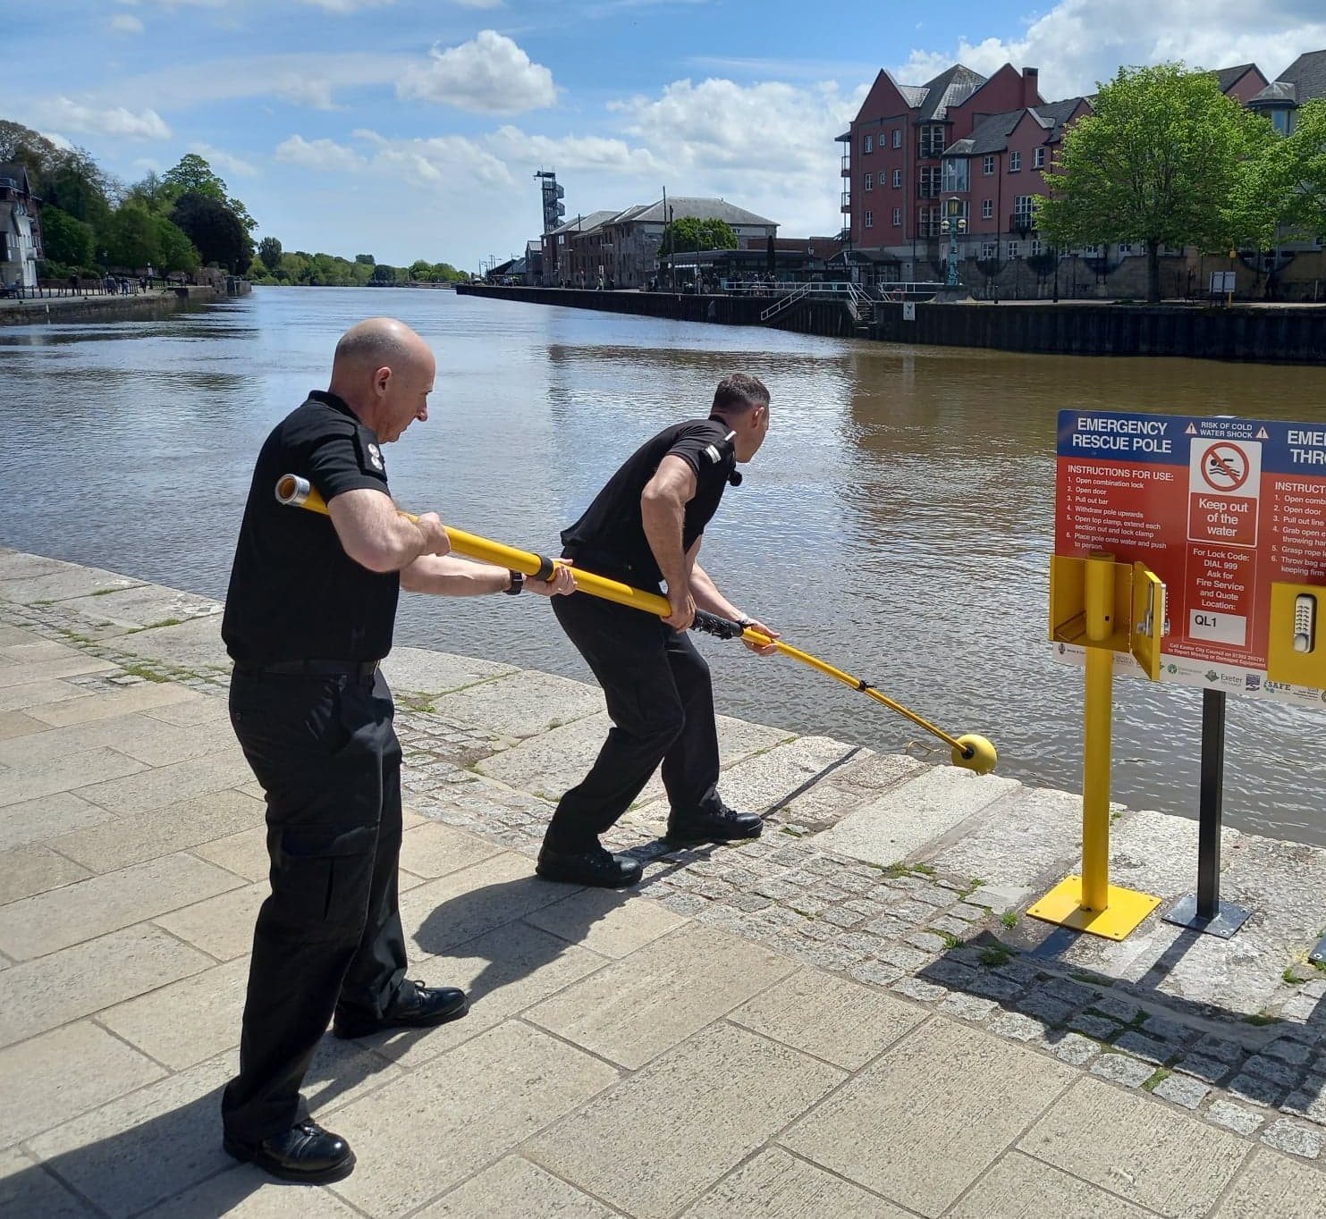
What Young People Should Know
Stay Safe
  Stop and Think
  Stay Together
  Avoid jumping into unknown water
  Get out if cold
If something goes wrong
  Float to Live
  Call 999
Never enter the water to rescue

Slide 7
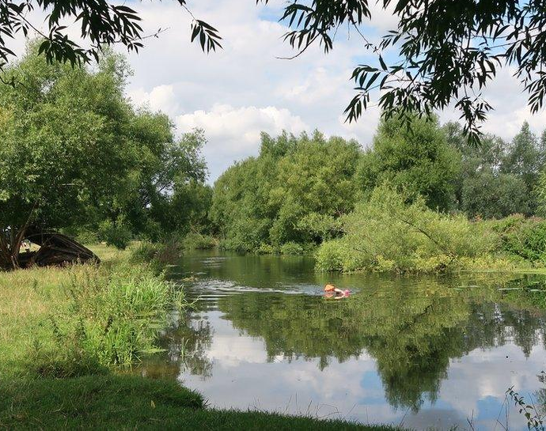
What You Can Do
Talk about risks
Set clear boundaries
Encourage safe places
Remind them: Don’t take risks and avoid showing off
Even strong swimmers can get into difficulty

Slide 8
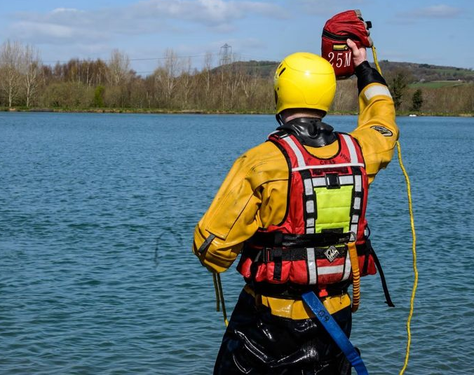
Remember
Float to Live
Most incidents are preventable
Have the conversation at home
That conversation could safe a life

