Slide 1
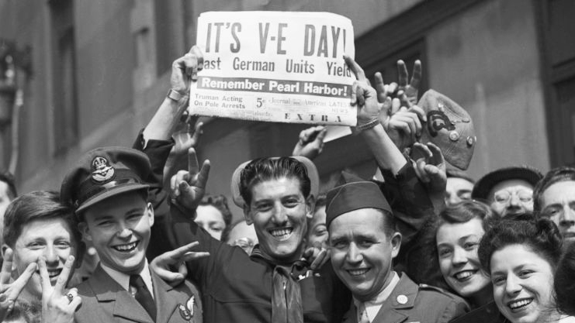
VE Day 80th Anniversary
Thursday 8th May 2025
Humanities Student Leaders
Notes:
Miss Hooper

Slide 2
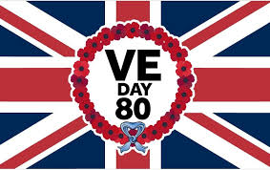
VE day 2025
Presented to you by your Humanities Leaders!!
By the end of this assembly, you shall know all about the end of the second world war!

Slide 3
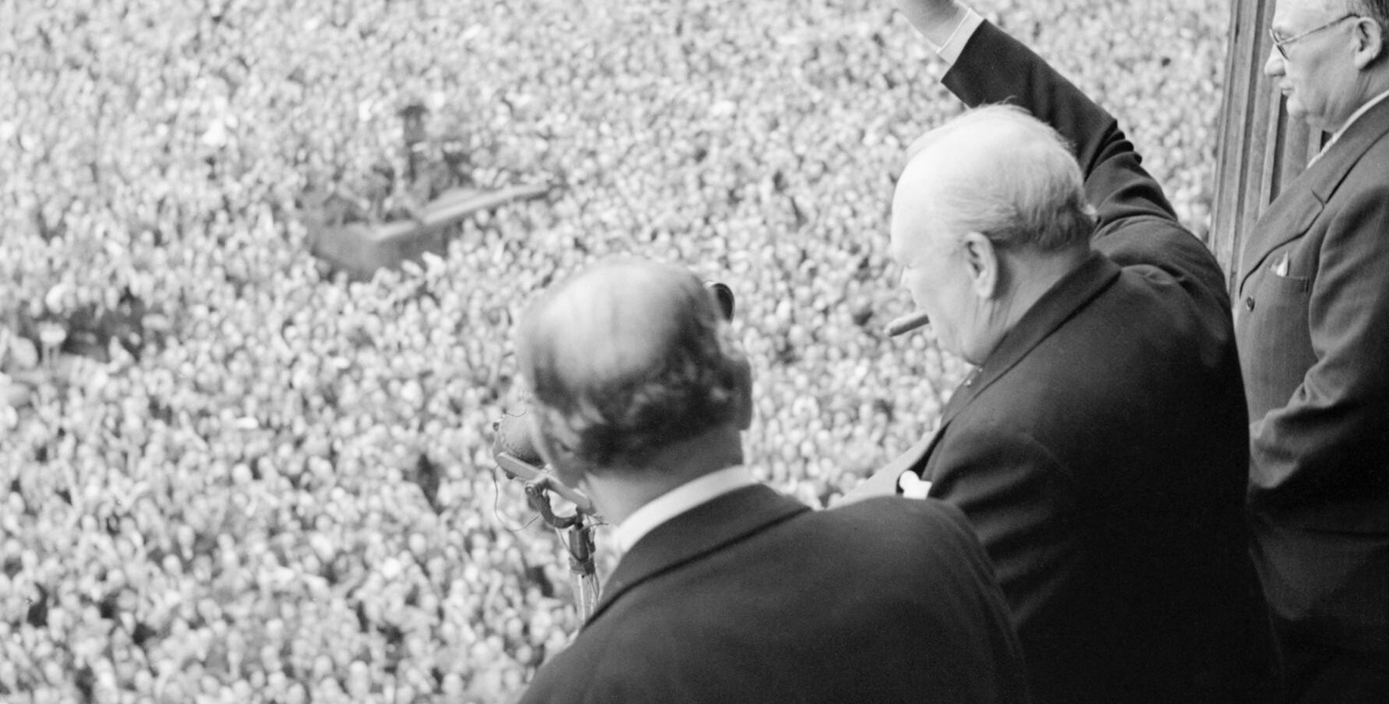
On June 6th 1944, British, US and Canadian forces landed on the beaches of France.
They pushed back the Nazi forces in France and liberated France on August 25th 1944.
On the Eastern Front, the USSR soldiers pushed the Nazis back through Poland.
By April 1945, Hitler knew the war was over and committed suicide.

Slide 4
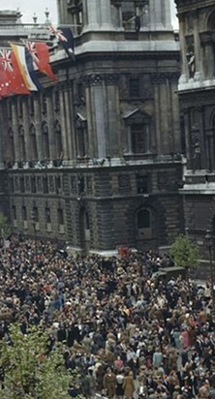
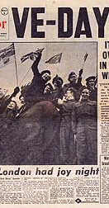
What happened on the
8th May 1945?
Winston Churchill (the wartime Prime minister of Britain) announced to the masses that Germany had unconditionally surrendered the previous day! Celebrations broke out in the streets, with parties and concerts taking place throughout Britain and the rest of Europe.

Slide 5
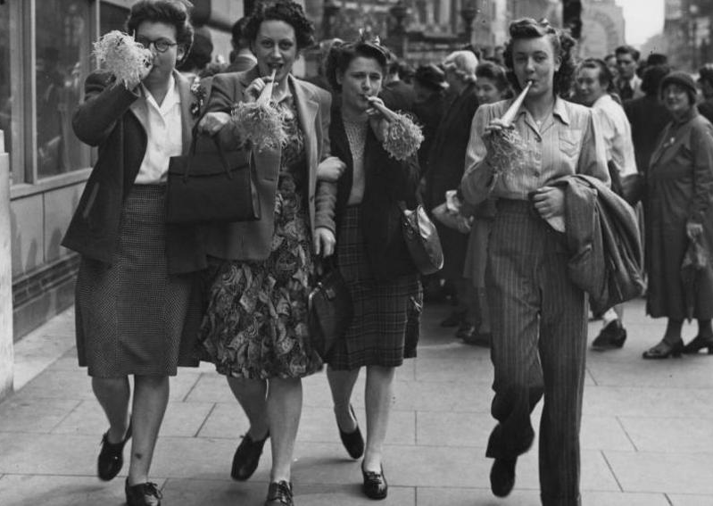
V-E Day, or Victory in Europe Day, happened on May 8th 1945, and it marked the official end of World War II in Europe.
On this day, Nazi Germany surrendered to the Allied forces, which included the United States, the United Kingdom, and the Soviet Union.

Slide 6
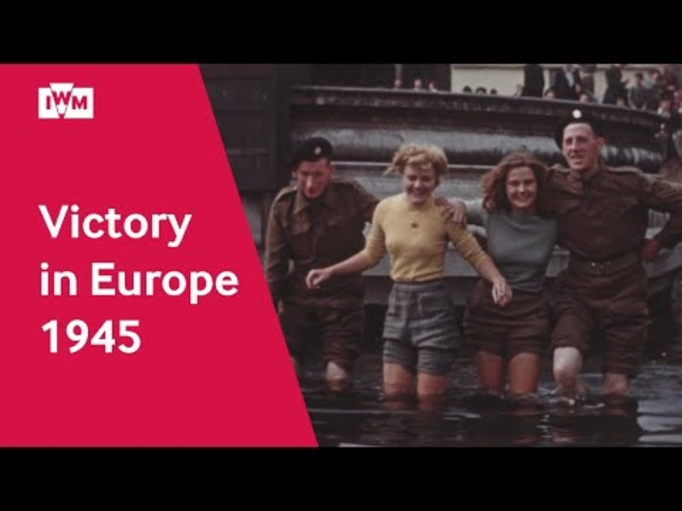

Slide 7
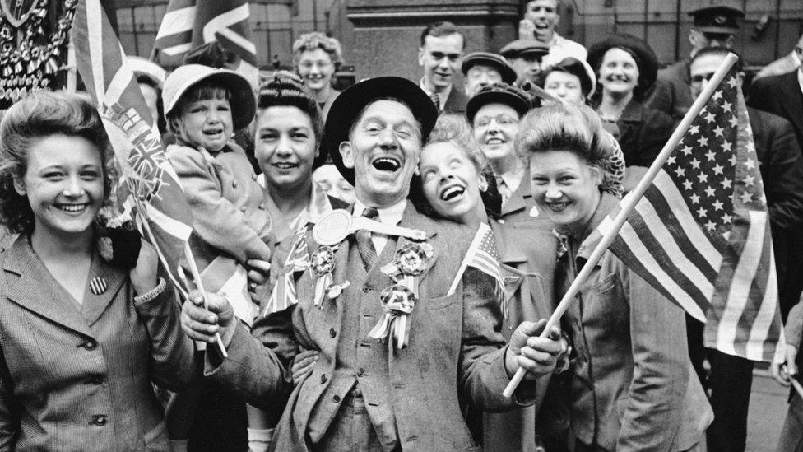
WHY DO WE CELEBRATE
VE DAY?
We celebrate VE day to mark the end of WW2 in Europe, however this was not the end of the war, the war in the Far East between the Allies and Japan would still carry on for 3 months.
On May 8th, 1945, Germany surrendered to the allies. This caused people in most areas in the world to celebrate and rejoice.
However, though this was the official end of the war in Europe, the soldiers did not come back home until weeks or even months after, as they needed to restore public order and assist in the welfare of destroyed societies.

Slide 8
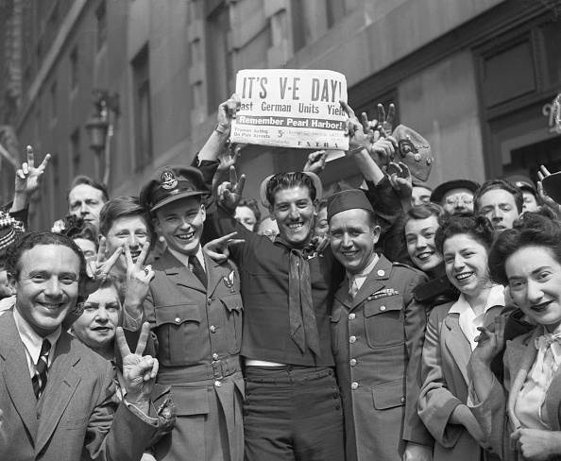
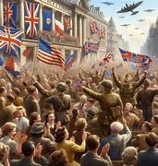
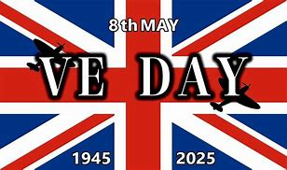
What is the significance of VE Day?
VE Day stands for Victory in Europe day. It is celebrated on May 8th each year and marks the day when the Germans surrendered to the allied forces. This year marks the 80th anniversary. But why is it significant? Here are some of the reasons why we celebrate it.
It marked the end of World War II in Europe. People had been fighting for 6 years. VE Day commemorates the surrender of the Germans
It honors those who died in the war. Around 70 million people died and 17 million were injured in battle.
It shows a symbol of togetherness. VE Day highlights the success of cooperation between countries like Britain, France, and the USA
Made by Euan Johnson (8RV)

Slide 9
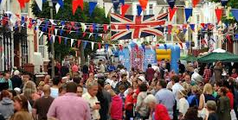
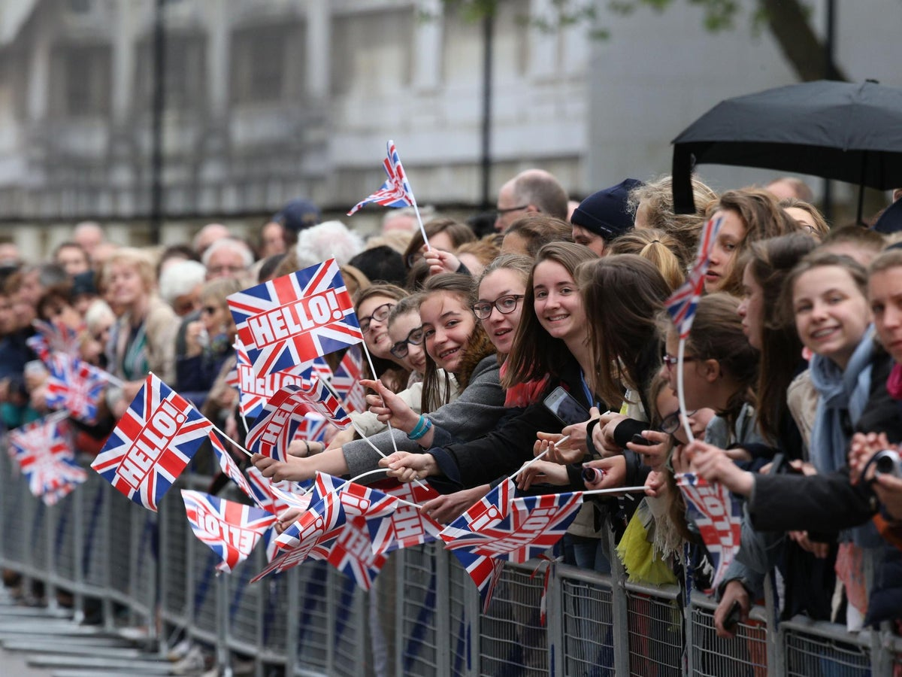
How do we celebrate it today?
Our traditions have mostly stayed true to their origins with street parties, concerts, and military fly-past's being the main ways we celebrate the allied victory over the Nazis in 1945. As we celebrate 80 years since the first VE Day, there will be a four-day long celebration; including a military procession and fly past, beacon lighting across the country, a national toast to the heroes of WWII and even royal participation.

Slide 10
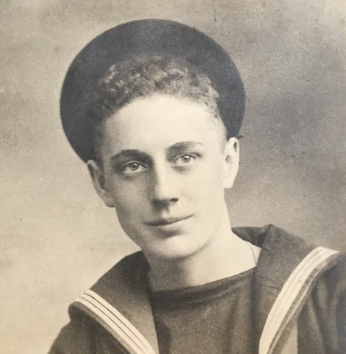
Survivor's story- Ray Smith
“VE Day was truly a day of celebration! We docked and learnt of the surrender of Germany when we came back into port. We were all given leave which was met with exhilaration and relief – we wanted to be out and about celebrating with everyone else.”
“We ended up going to London and joining in the celebrations right in the middle of Trafalgar Square and ended up partying all day long, meeting some lovely WRENs along the way who we ended up sleeping in a shop doorway with as there were no hotels available – but we didn’t care it had been the best day ever!”

Slide 11
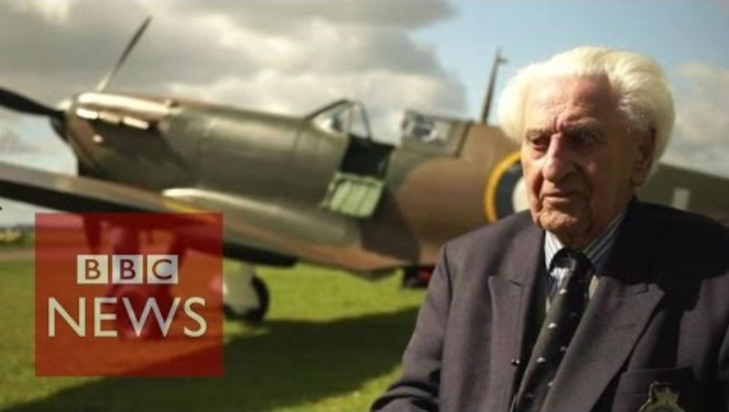
Notes:
https://www.youtube.com/watch?v=c7TifYolOXk

Slide 12
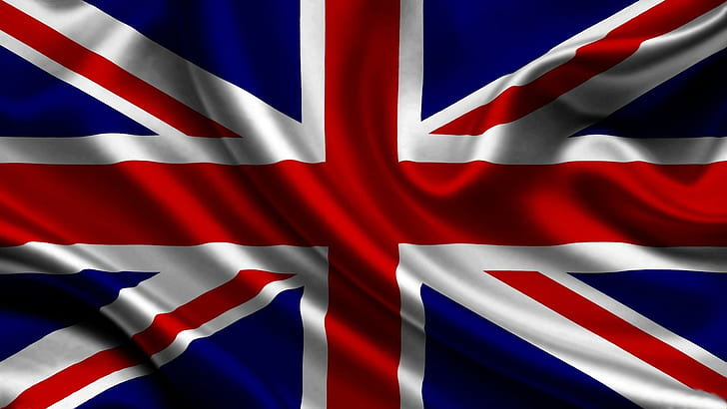
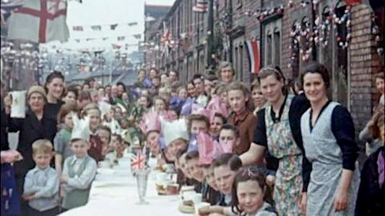
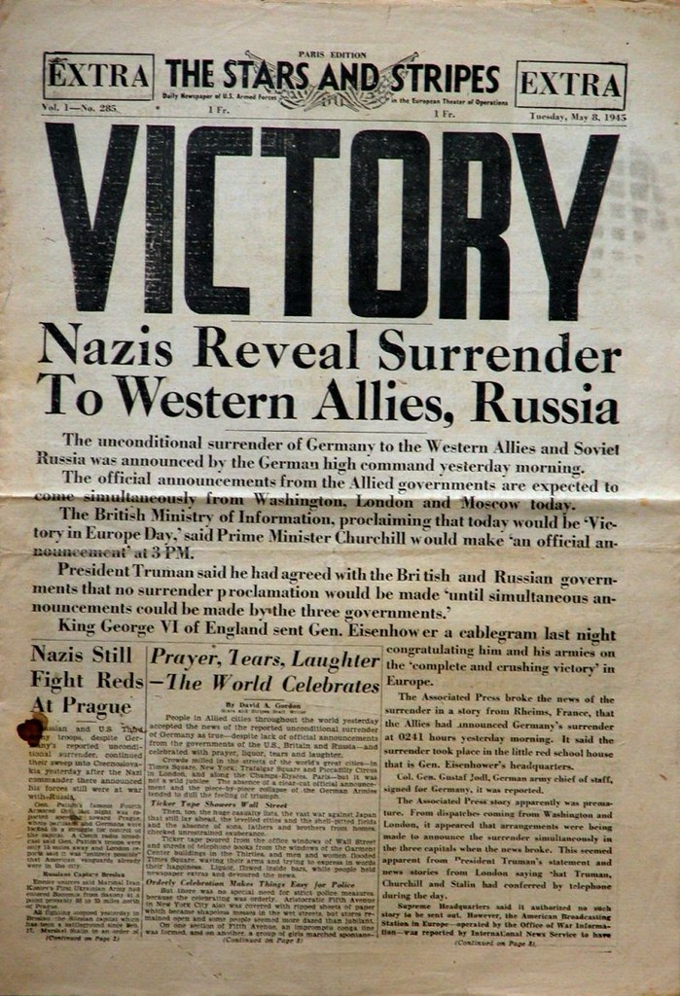
How can Ousedale celebrate VE Day?
VE day had lots of the celebration 80 years ago but how can we celebrate it today? Here are some of the ways we can celebrate VE Day
Flags and decorations to remind people of the celebration
A letter to our school from a veteran who survived
KS3 Design your own bunting competition in form time
Some cupcakes can be on sale to raise money for Veterans
Made by Euan Johnson (8RV)

